Slide 1
Python Enablement for Gen AI
Ajay J. Singala

Slide 2
Connect
Ajay.Singala@gmail.com
https://www.linkedin.com/in/ajay-singala-bb0b771/

Slide 3
Performance Latency and Cost Optimization

Slide 4
Cost Awareness

Slide 5
Cost Awareness
Token Usage Fundamentals
  LLM cost = Input tokens + Output tokens
  Tokens ≠ words (roughly: 1 token ≈ ¾ word)
  Example
    Prompt:
      “Summarize this policy in 3 bullet points”
    Short prompt → fewer tokens → cheaper
    Long prompt with unnecessary context → higher cost
  Key Insight
    Every extra word you send = money spent

Slide 6
Cost Awareness
Prompt Shortening Techniques
  Bad Prompt
    “You are a highly intelligent assistant. Please carefully analyze the following document and provide a detailed but concise answer…”
  Better Prompt
    “Summarize in 3 bullets:”
  Techniques
    Remove:
      Role fluff (“You are an expert…”) where not required
      Redundant instructions
    Use:
      Bullet constraints
      Structured prompts
  Example
    Instead of:
      “Explain the reimbursement policy in detail”
    Use:
      “List reimbursement limits in bullets”
    Same output quality, lower cost

Slide 7
Cost Awareness
Response Caching Strategies
  Idea
    If the same question comes again → don’t call the LLM again
  Example
    Customer asks:
      “What is the travel reimbursement policy?”
    First time → LLM call
    Next 100 times → return cached answer
  Types of Caching
    Exact match caching
    Semantic caching (similar questions)
  Benefit
    Can reduce cost by 50–90% in production

Slide 8
Cost vs Quality Trade-offs
Approach | Cost | Quality | When to Use
Small model | Low | Medium | FAQs, classification
Large model | High | High | complex reasoning
Short prompt | Low | Medium | simple tasks
Long context | High | High | RAG-heavy tasks

Slide 9
Latency Optimization

Slide 10
Latency Optimization
Async LLM Calls
  Idea
    Don’t wait for one call to finish before starting another
  Example
    Instead of:
      Get summary
      Then generate keywords
      Then classify
      Do:
        Run all 3 at the same time
    Result
      Sequential: 6 seconds
      Async: 2 seconds

Slide 11
Latency Optimization
Parallel Retrieval & Tool Execution
  Problem
    RAG systems often:
      Retrieve docs → then call tools → then LLM
  Better Approach
    Do retrieval + tool calls in parallel
  Example
    User asks:
      “What is policy and reimbursement total for 3 days?”
    System:
      Retrieve policy docs
      Calculate cost
      At the same time

Slide 12
Latency Optimization
Latency Measurement Techniques
  What to Measure
    LLM response time
    Retrieval time
    Tool execution time

Slide 13
Latency Optimization
User-Perceived vs System Latency
  System Latency
    Actual processing time
  User-Perceived Latency
    What user feels
  Trick
    Streaming responses
  Example
    Without streaming → user waits 3 sec
    With streaming → user sees response in 0.5 sec
    Same system latency, better experience

Slide 14
Production Readiness Review

Slide 15
Production Readiness Review
Reliability & Fallback Strategies
  Why?
    LLMs can fail:
      Timeout
      Hallucination
      API errors
  Strategies
    Retry (2–3 times)
    Fallback model
    Rule-based backup
  Example
    If LLM fails, return:
      “Unable to process. Showing policy summary instead.”

Slide 16
Production Readiness Review
Observability Coverage Checklist
  Track everything:
    Inputs
      Prompt
      Retrieved documents
    Outputs
      LLM response
      Confidence / evaluation score
    Metrics
      Latency
      Cost
      Errors
  Without observability = blind system

Slide 17
Production Readiness Review
Readiness for Real-World Traffic
  Challenges
    High concurrency
    Spikes (sale events, peak hours)
  Example
    During sale:
    10 → 10,000 users suddenly
  What to Ensure
    Rate limiting
    Queueing
    Load balancing

Slide 18
Production Readiness Review
Common Production Anti-Patterns
  1. Overloading prompts
    Too much context → high cost + slow
  2. No caching
    Repeated identical calls → waste of money
  3. Using one model for everything
    Expensive and inefficient
  4. No monitoring
    Issues detected too late
  5. Sequential workflows
    Slow systems

Slide 19
Summary
Cost Optimization = “Don’t spend unnecessary tokens”
Latency Optimization = “Don’t make users wait”
Production Readiness = “Don’t let the system fail in real life”
So,
  Reduce tokens → reduce cost
  Parallelize → reduce latency
  Cache aggressively → save money
  Monitor everything → ensure reliability
  Use right model for right task

Slide 20
Demo
Performance, Latency & Cost Optimization

Slide 21
Thank you
Ajay J. Singala
ajay.singala@gmail.com
https://www.linkedin.com/in/ajay-singala-bb0b771/
Indian Achievers Magazine: https://shorturl.at/lLDdQ
Book: https://amzn.in/d/0bnRMSMG
Autonomous Agents in Enterprise Software Delivery
40

Slide 22
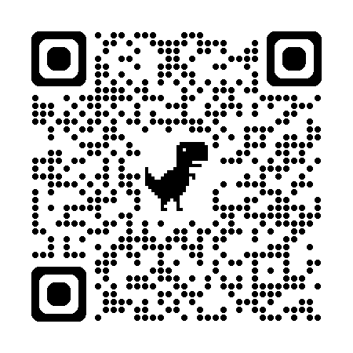
Thank you
Feedback:
https://upgrad1.typeform.com/to/bSKs4OZV

Slide 23
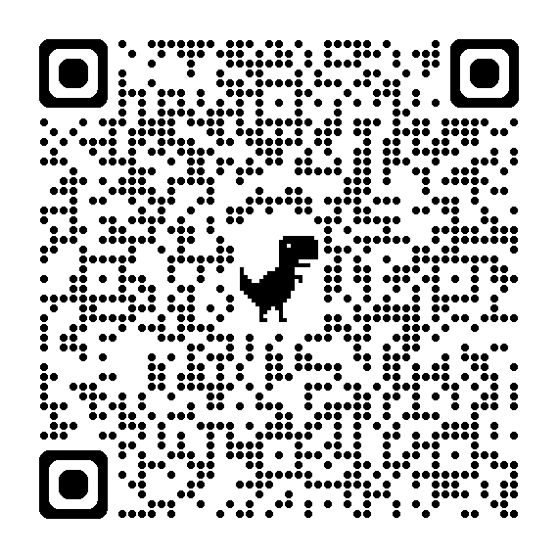
Thank you
Post-Assessment:
https://forms.cloud.microsoft/r/z749XzLRCR

